Slide 1
REVENUE CURVES

Slide 2
Introduction
Total amount of money value received by a firm or an industry by selling the goods and services is known as the revenue.
For example if a firm produce 100 units of commodity per day and sells it at Rs.20 per unit then its total revenue is Rs. 2000 per day.
The revenue can be classified into three category such as ;
a. Total Revenue (TR).
b. Average Revenue (AR).
c. Marginal Revenue (MR).
Each curve have different characteristics for different market structure.

Slide 3
Total Revenue (TR):
Total sum of money value received from the sales of various quantities of output of product produced during a given period of time at certain price level is known as total revenue of a firm or an industry for that time period.
It can be obtained by multiplying total output sold (Q) by the corresponding price (P). i.e. TR = P × Q
Average Revenue (AR): Per unit revenue of a product is known as average revenue.
We obtain AR by dividing (TR) by the corresponding quantity sold (Q).

Slide 4
Marginal Revenue (MR):An additional amount of money received from the sells of one additional unit of a product or output.
Where, TRn is the total revenue obtained from the sales of nth unit of output and TRn-1 is the total revenue obtained from the sales of (n-1) th unit of output. In other words, marginal revenue is the change in total revenue due to change in the quantity sold on the market by one unit. i.e. Where, Δ = change, Δ TR = change in total revenue ,Δ Q = change in quantity sold in the market.

Slide 5
Revenue curves under perfect competition
Perfect competition is the term applied to a situation in which the individual buyer or seller (firm) represent such a small share of the total business transacted in the market that he exerts no perceptible influence on the price of the commodity in which he deals.
Thus, in perfect competition an individual firm is price taker, because the price is determined by the collective forces of market demand and supply which are not influenced by the individual. When price is the same for all units of a commodity, naturally AR (Price) will be equal to MR i.e., AR = MR. The revenue schedule for a competitive firm is shown in the table 5.

Slide 6
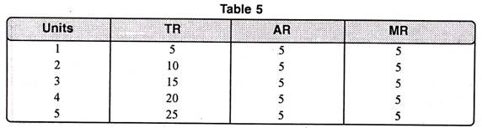

Slide 7
In table 5 we find that as output increases, AR remains the same i.e. Rs. 5. Total revenue increases but at a constant rate. Marginal revenue is also constant i.e. Rs. 5 and is equal to AR.
Thus,
TR = AR x Q
Also TR = MR x Q [Since AR = MR]

Slide 8
In figure 8, on the X-axis, we take quantity whereas on Y-axis, we take revenue. At price OP, the seller can sell any amount of the commodity. In this case the average revenue curve is the horizontal line. The Marginal Revenue curve coincides with the Average Revenue.
It is because additional units are sold at the same price as before. In that case AR = MR. A noteworthy point is that OP price is determined by demand and supply of industry.

Slide 9
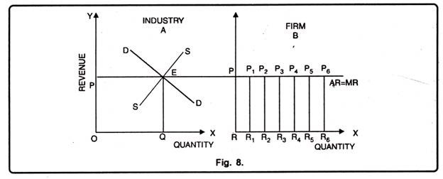

Slide 10
Revenue Curve under imperfect competition
When a firm is working under conditions of monopoly or imperfect competition, its demand curve or AR curve is less than perfectly elastic, the exact degree of elasticity being different in different market situations depending upon the number of sellers and the nature of product.
In other words, the demand/AR curve has a negative slope and the MR curve lies below it. This is because the monopolist seller ordinarily has to accept a lower price for his product, as he increases his sales.
Under imperfect competition conditions, total revenue increases at a diminishing rate. It becomes maximum and then begins to decline.

Slide 11
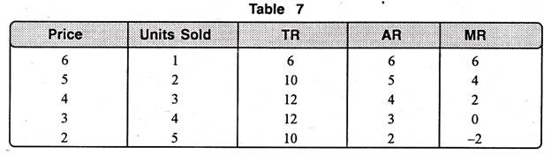

Slide 12
In table 7, 2 units can be sold at a unit price of Rs. 5, bringing in total revenue of Rs. 10. When 3 units are sold, the price per unit is lowered to Rs. 4 to make it possible for larger quantity to be sold. The total revenue in this case is Rs. 12.
The marginal unit is not bringing in Rs. 4 which is its price, but only Rs. 2. This is because the additional one unit is sold at Re. one less and the first 2 units which could have been sold for Rs. 5 are also sold at Rs. 4. i.e., Re. one less.

Slide 13
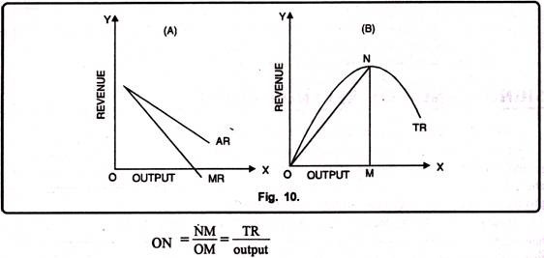

Slide 14
Fig. 10(A) shows that as additional units are sold when price comes down not only for the marginal units but also for other previous units. As a result, marginal units do not bring revenue equal to its price.
In fig. 10 (B), TR increases at a diminishing rate, becomes maximum at point N and then begins to decline. This has been represented by the curve TR. AR at any point on the TR curve is given by the slope of straight line joining the point to the origin. For instance, AR at any point N on TR curve is given by the slope of line.

